Slide 1
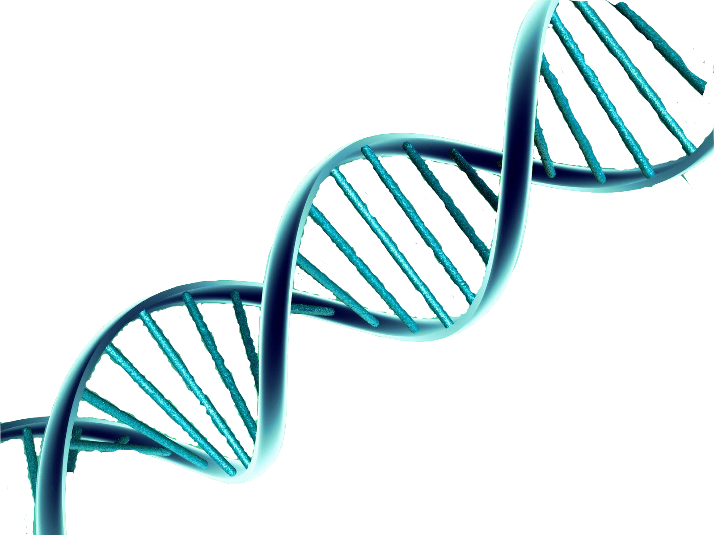
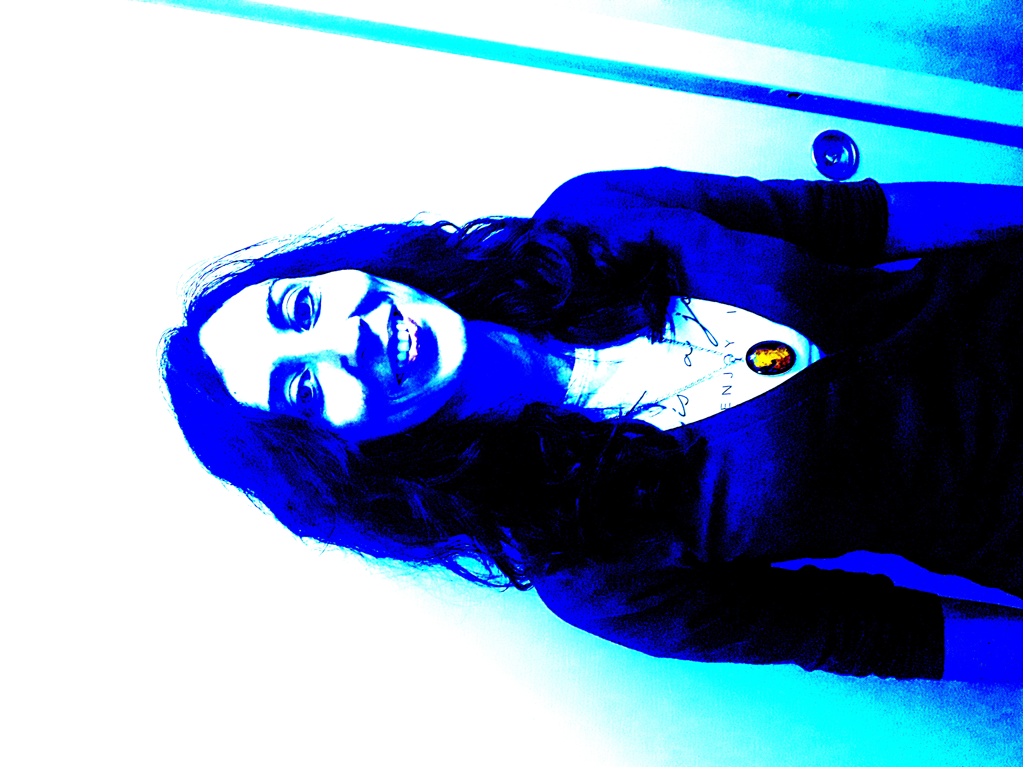
Programming Project 03
15-02-2022
Likelihood Protein Identification via k-mer Genetic Sequence Assembly
Team Presentation:
Faiza
Kriti
Elena Xerxa
Sarah

Slide 2
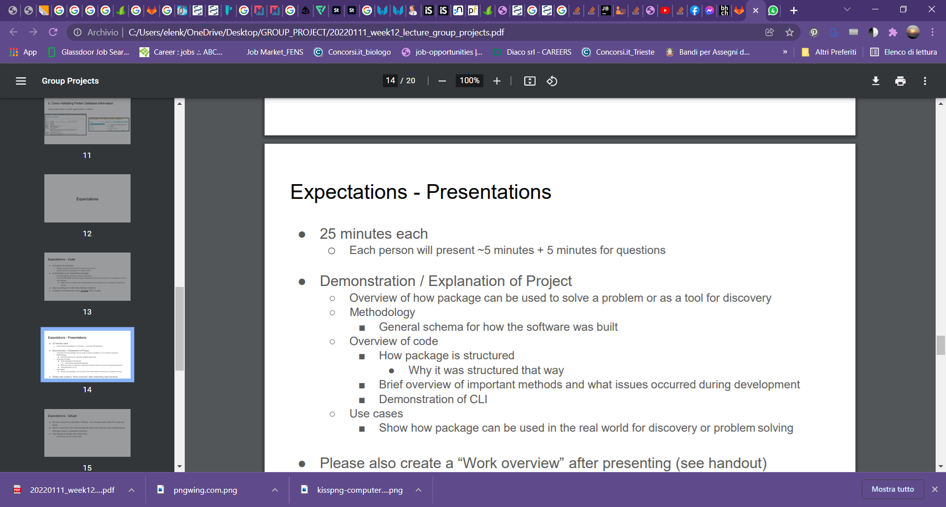
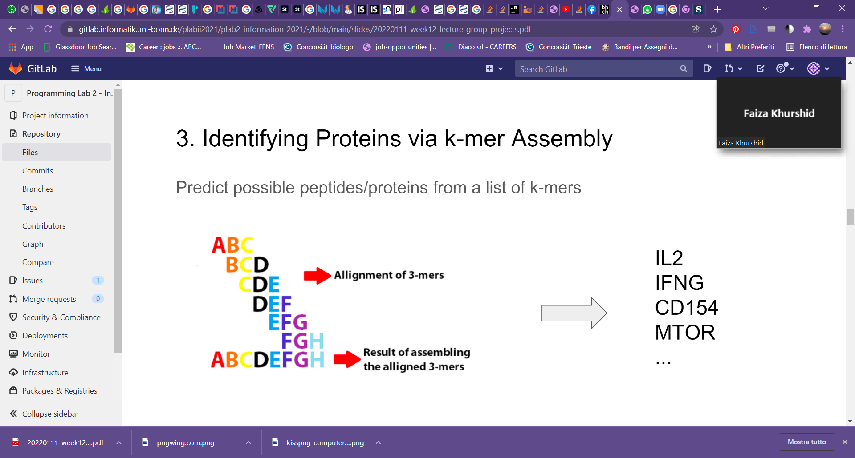
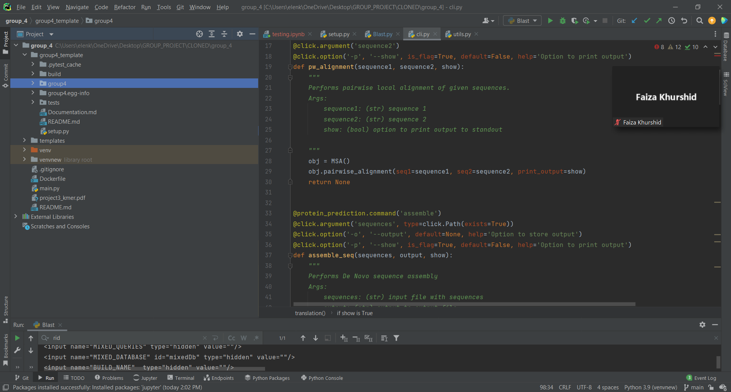
Faiza
mention that for each task we did a module, that we wrote wrapper function to be used for the CLI and the GUI, etc.
make an example.

Slide 3
Outline
1. Strands, Assemble!
2. Central Dogma
3. Protein Prediction
4. Dockerfile and GUI
NB The titles can be changed, I just wrote the same written in Bruce task

Slide 4
1. Strands, Assemble!
Krity

Slide 5
Outline
1. Strands, Assemble!
2. Central Dogma

Slide 6
2. Central Dogma
Krity

Slide 7
Outline
1. Strands, Assemble!
2. Central Dogma
3. Protein Prediction

Slide 8
3. Protein Prediction
Elena

Slide 9
Outline
1. Strands, Assemble!
2. Central Dogma
3. Protein Prediction
4. GUI

Slide 10
Dockerfile and GUI
Show case usage
Sarah

Slide 11
Thanks!
Any questions?
You can find me at @username & user@mail.me

